Slide 1
Eric Sommerville Presiding Member, Northern and Yorke Natural Resources Management Board
Sustainable Agriculture; Farmers Engaged in
Natural Resource Management

Slide 2
2015 – 2018 Business Plan
Productive Partnerships
Catchment Connections
Coasting Along
Life on the Edge
Must do Management

Slide 3
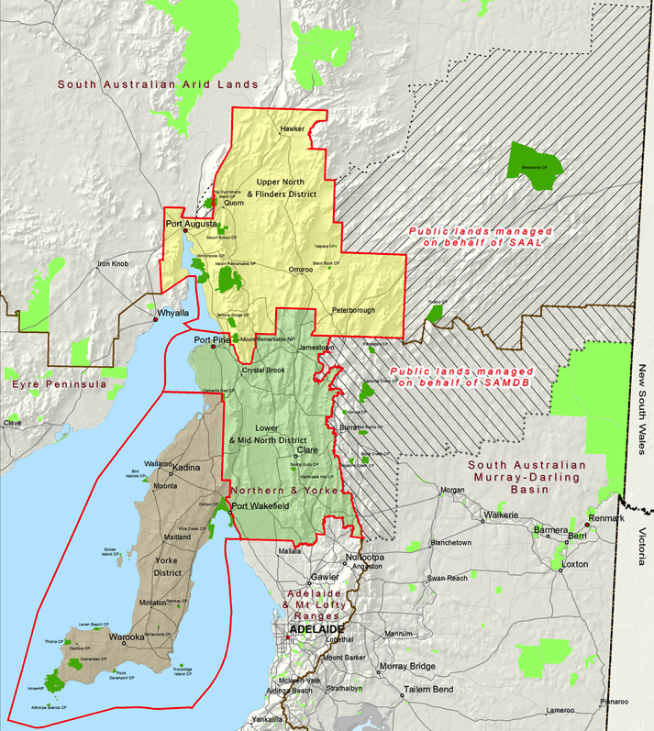

Slide 4
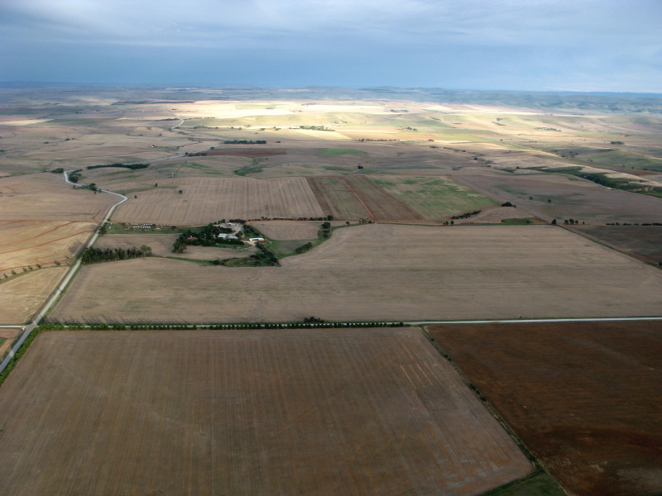
Production Dominated Landscape

Slide 6
9 HORSEPOWER

Slide 7
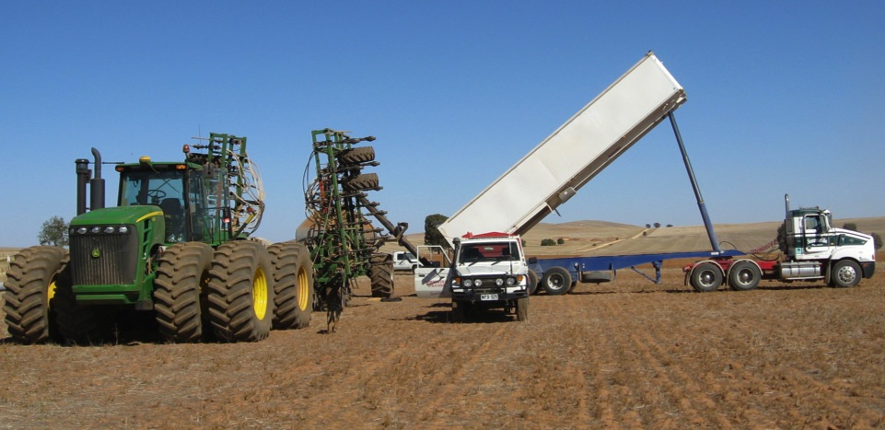
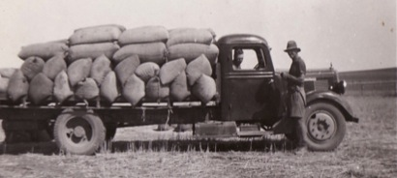
450 HORSEPOWER

Slide 8
24/7 seeding

Slide 9
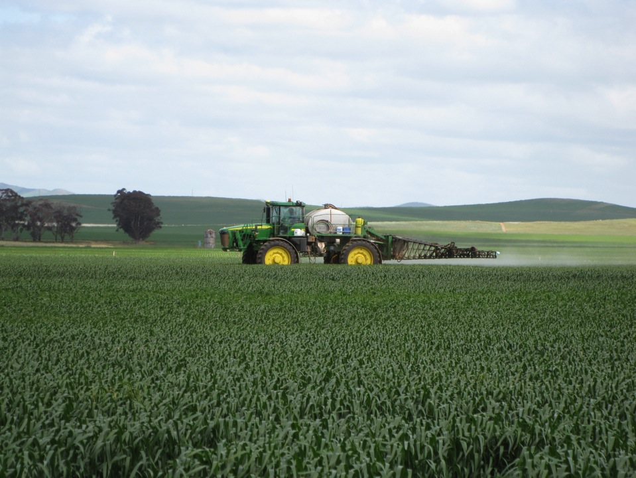

Slide 11
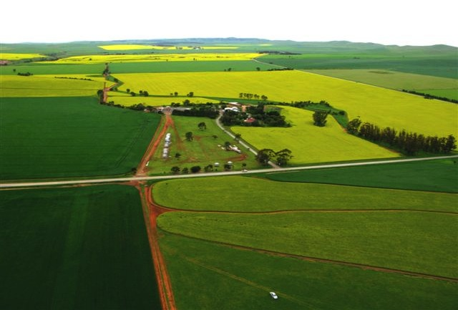
2015 100% Cropping

Slide 12
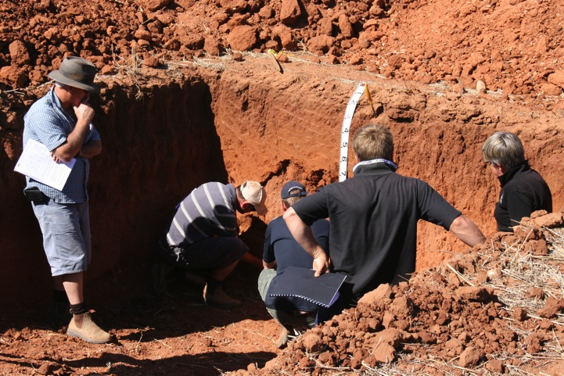
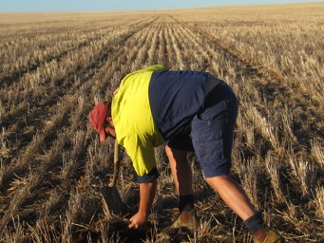
Soils…
We have a better understanding of our soils

Slide 13
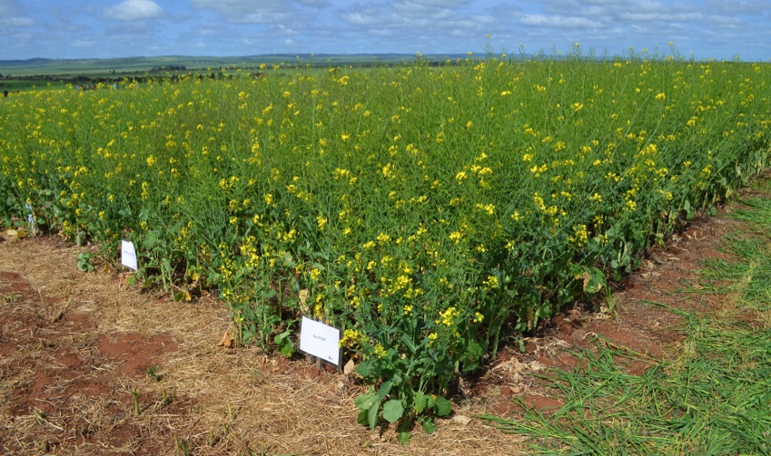
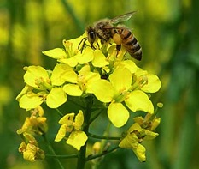
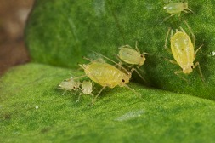
We host NVT trials

Slide 14
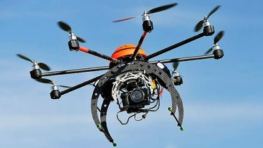
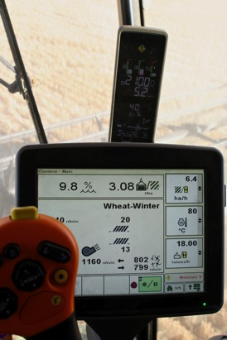
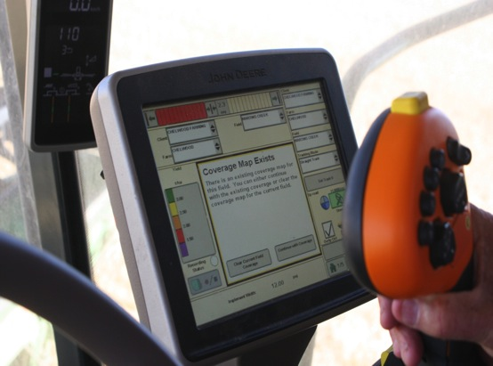
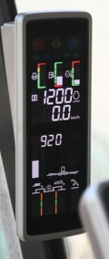

Slide 15
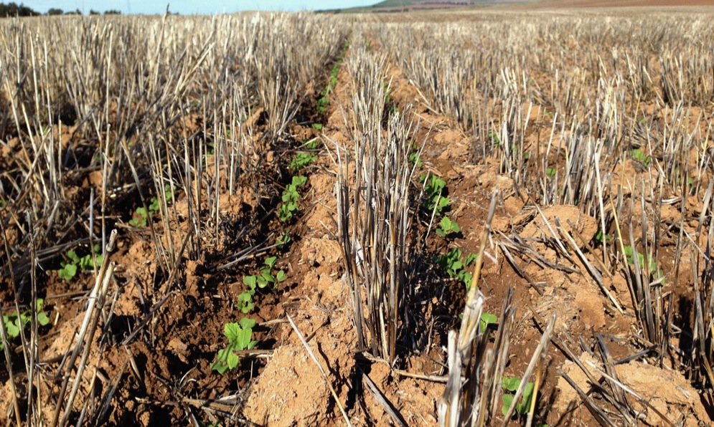
We use a ‘one-pass’ tillage system and inter row sow

Slide 16
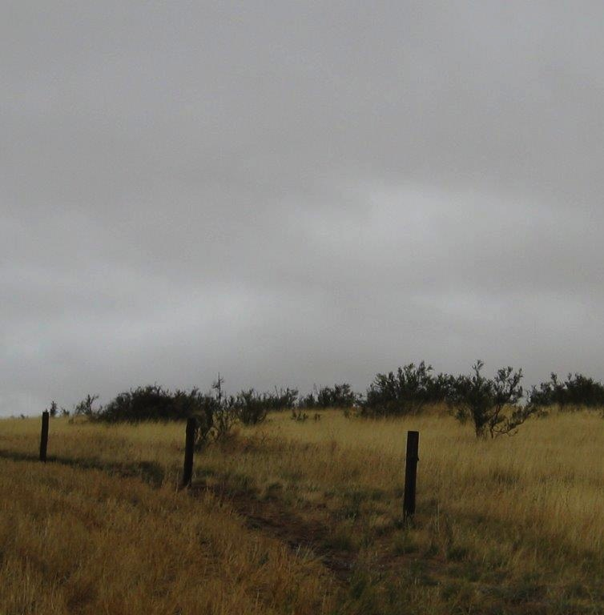
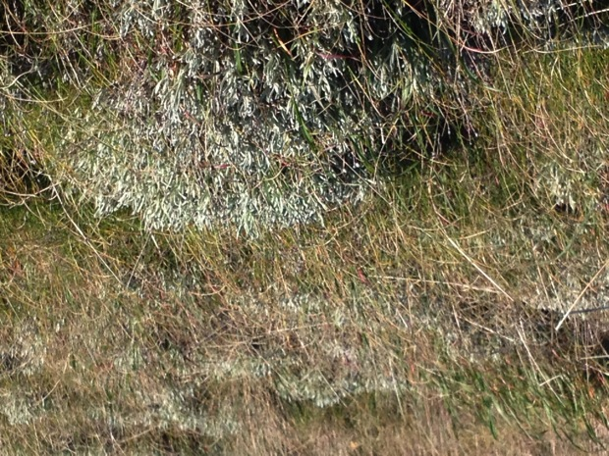
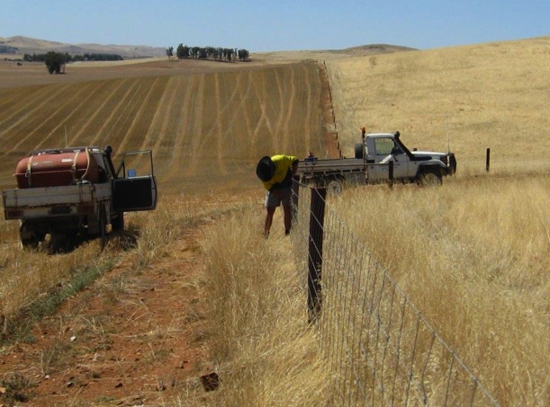
.

Slide 17
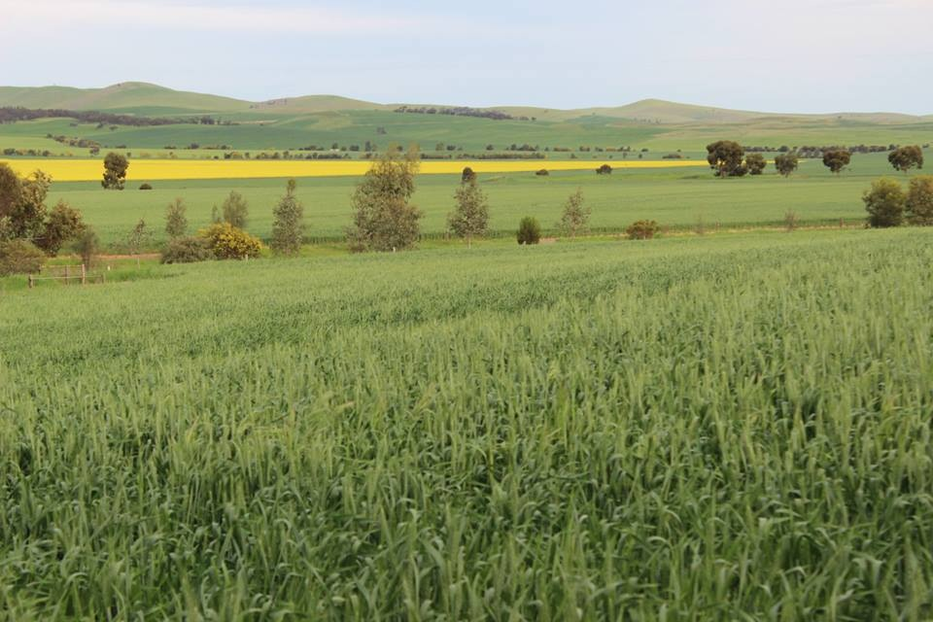

Slide 18
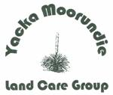

Slide 19
Formed in 1998 with Shearer’s Quarters Meetings
2 - 3 meetings per year plus project work
Originally focused on tree planting
Now focused on networking & information and community education and engagement
Supported by;
Memberships
NRM
Landcare
Councils
Private Industry.

Slide 20
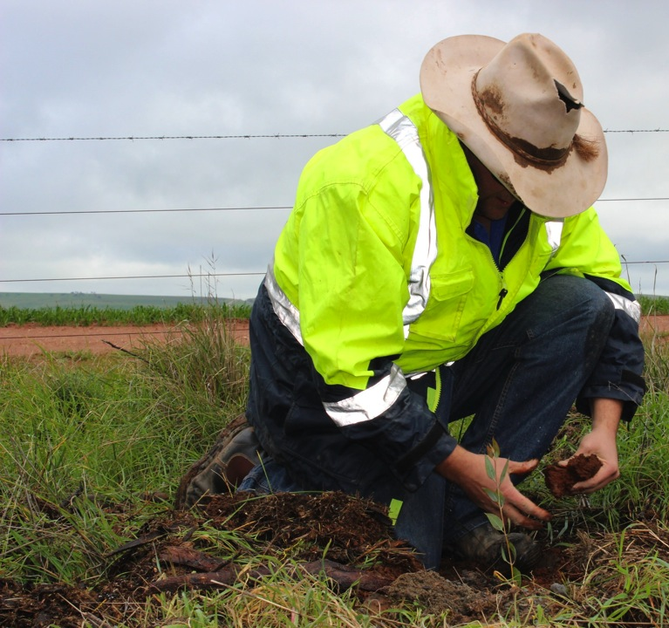
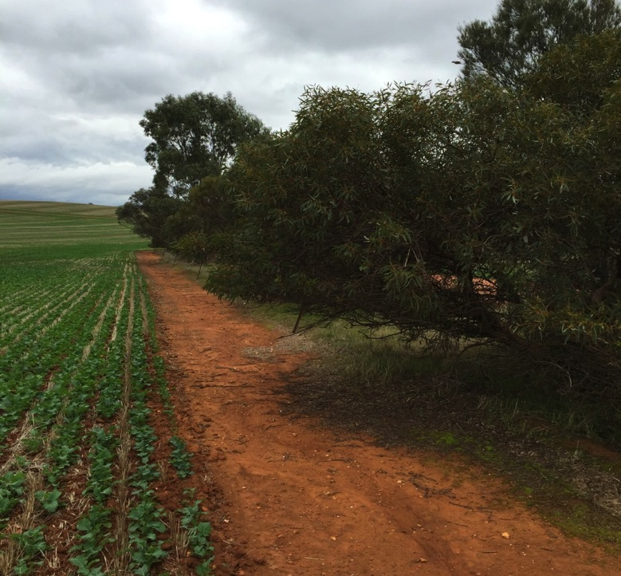

Slide 21
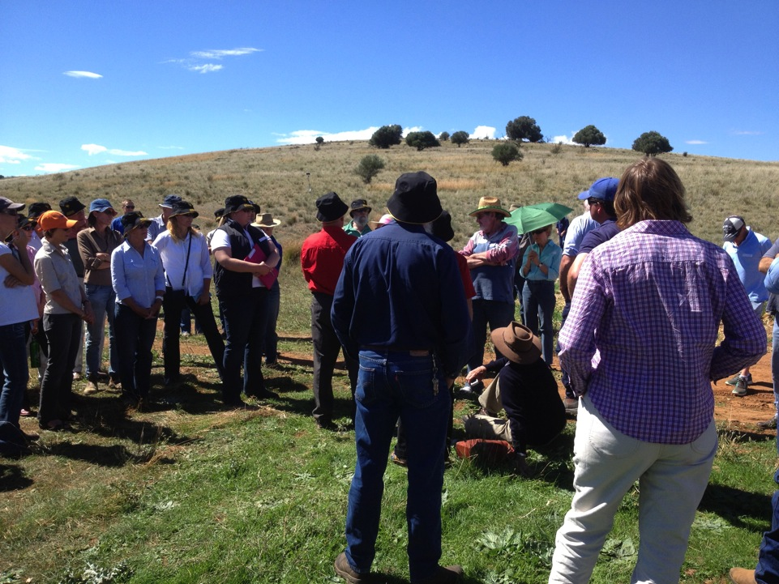

Slide 22
Education Day 2013
Notes:
120 students

Slide 23
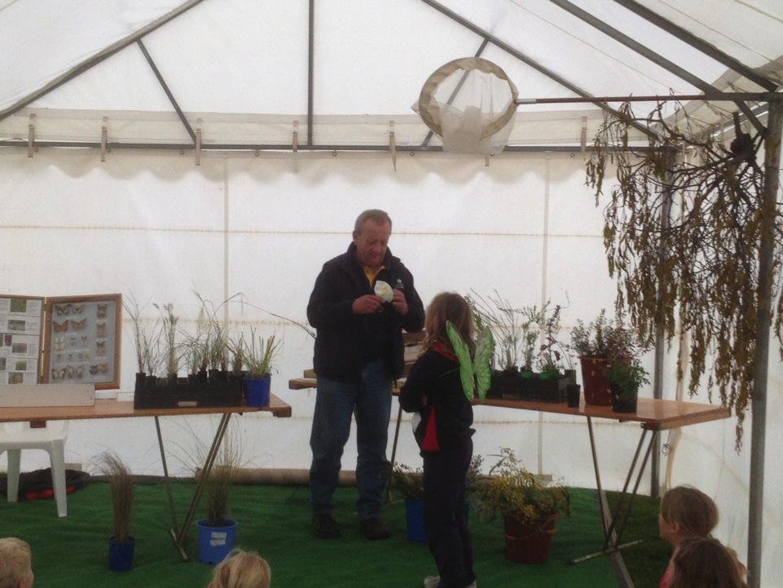
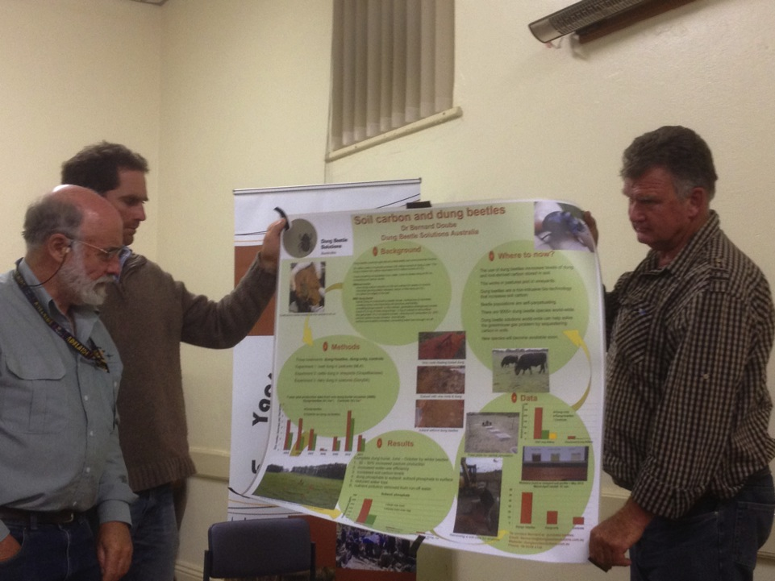

Slide 24
Northern & Yorke NRM Board

Slide 25
CONSERVATION ACTION PLANNING

Slide 26
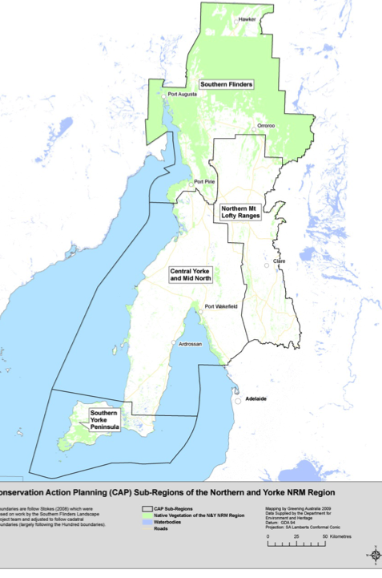
Soil, Water & Biodiversity CAP’s across the N&Y Region

Slide 27
Delivery Partners
Greening Australia
SA Water
DEWNR
Conservation Volunteers
Nature Conservation Society of SA
Central Local Govt Region of SA
The Wilderness Society
Aboriginal Lands Trust
Ag Ex Alliance
Trees for Life
Rural Solutions
Forestry SA

Slide 28
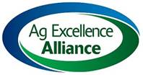
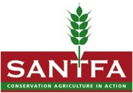
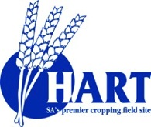
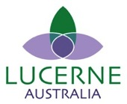
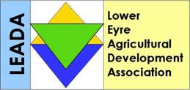
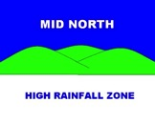
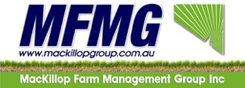
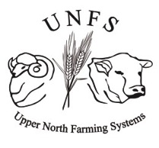
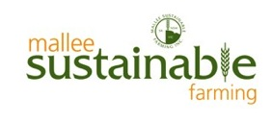
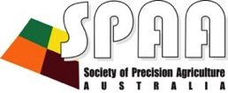

Slide 29
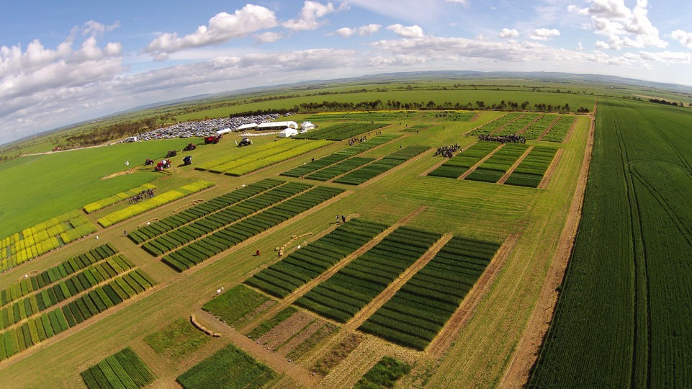

Slide 30
Coast and marine
Marine debris project ( Adelaide Mount Lofty Region NRM, Kangaroo Island NRM and Northern and Yorke NRM)
Land
Biodiversity Fund round one project (Bush Heritage and Plumbago station )
Conserving the biodiversity assets of the Northern and Yorke Agricultural District (Greening Aust and Trees For Life)
Controlling grassy weeds in no-till production (Northern Sustainable Soils)
Development of next generation property management planning (State NRM Program Sustainable Dryland Ag Initiative)
Improving pasture sustainability and production through production zoning (Upper North Farming Systems)
Improving soil cover on erodible soils ( Ag Ex Alliance)
Increasing sustainability in the Northern and Yorke agricultural sector ( Federal funding with mutiple partners)
Living Flinders: maintaining ecological integrity and resilience in the Southern Flinders Ranges (Greening Aust ,Aboriginal Lands Trust and Nature Conservation Society of Sth Aust)
Regional Landcare Facilitator
Sustainable resource management though poultry and cropping collaboration (Sth Aust No Till Farmers Assoc)
Understanding soil nitrogen and acidification under no-till systems
Understanding the ecology of pest snails
Native species
Bushland condition monitoring (Nature Conservation Soc of Sth Australia)
Four Catchments
Improving ecological integrity and resilience on the Southern Yorke Peninsula (Greening Australia, Aboriginal Lands Trust and Nature Conservation Society of Sth Australia)
Local communities restoring critical habitat and landscape linkages in the southern Yorke Peninsula
Mount Remarkable to the sea: Upper Spencer Gulf coastal protection and riparian linkages
Vegetation protection on the Wakefield River

Slide 31
Fox Baiting (NRM and NLP funded)

Slide 32
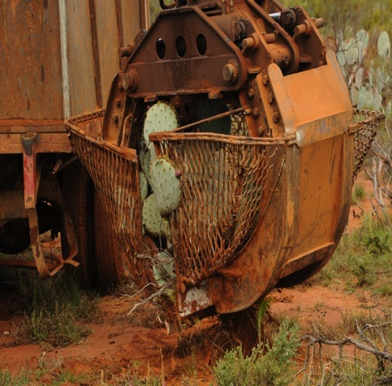
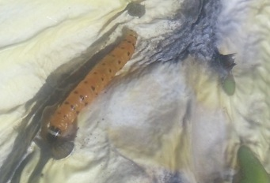
Wheel Cactus Control

Slide 33
Young Environmental Leaders
Quorn Area School Native Bush Garden 2015
Notes:
21 participating schools in 2015

Slide 34
Four Catchments Project
Willochra, Broughton, Wakefield and Light Rivers

Slide 35
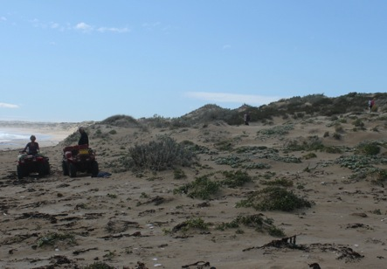
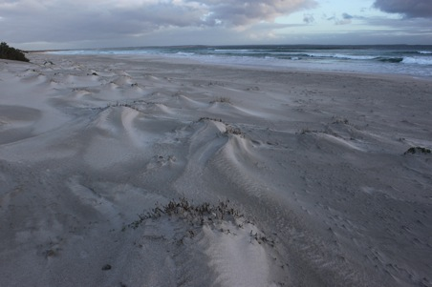
Beach Daisy
West of the Peesey Biodiversity Restoration Group through a N&Y NRM Community Grant began initial control of Beach Daisy.
Beach Daisy has been eradicated on Blue Bay, Berry Bay and Gym Beach. Eradication is now achievable Formby Bay.

Slide 37
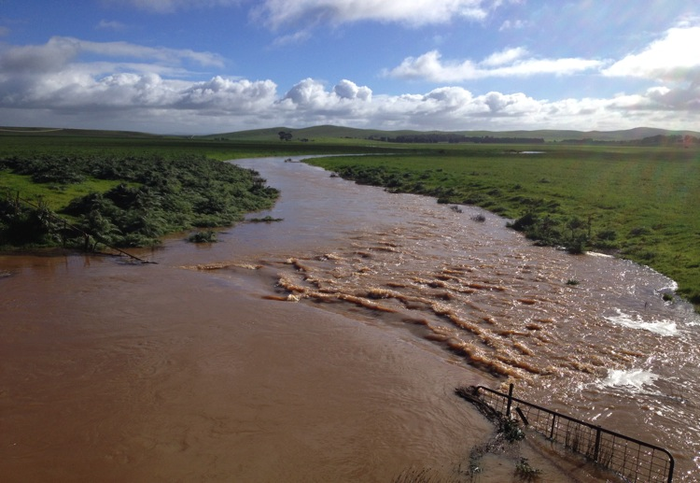
SCARY THINGS

Slide 38
Probable collapse of pollination services by honey bees
New diseases & herbicide resistance
More extreme weather events
Water: An asset we must protect
Nutrients: Peak Phosphorous
Fish depletion
Fossil Fuels
Feral Animals, in particular cats
Loss of Agricultural land to urban sprawl and lifestyle blocks
Population

